Slide 1
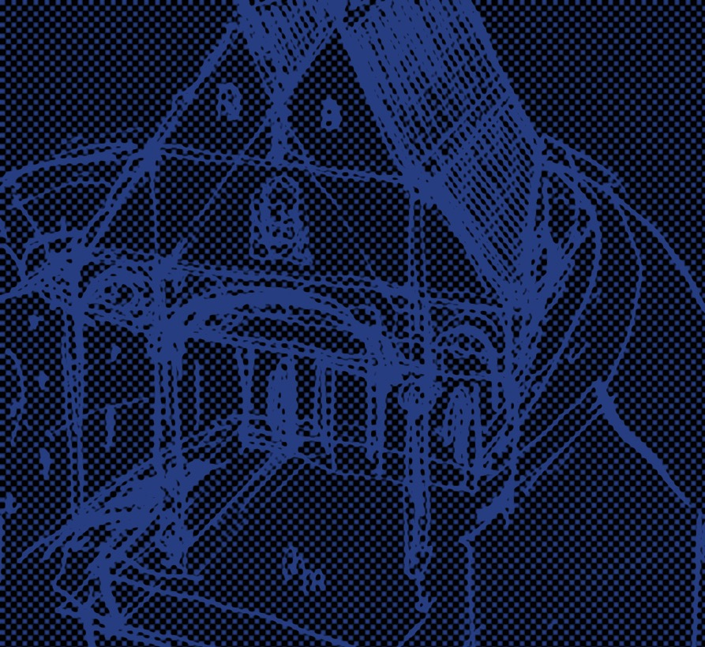
Text
"Look thee, I speak play scraps"
Digitally mapping intertextuality
in early modern drama
Regula Hohl Trillini (University of Basel)

Slide 2
WordWeb / IDEM
An online database of extracts from early modern plays
Funded by the Swiss National Science Foundation
Based at the University of Basel
Department of English
Digital Humanities Lab

Slide 3
WordWeb / IDEM
The Corpus
The Website
Research

Slide 4
WordWeb / IDEM
The Corpus
The Website
Research

Slide 5
The Corpus
Passages from British plays
written between 1533 and 1688
2500 extracts and counting
Metadata: Martin Wiggins' Catalogue of British Drama 1533-1642 (OUP)
Texts will be available in modern spelling
Shakespeare's texts will be quoted from
http://www.folgerdigitaltexts.org

Slide 6
The Corpus
What makes a passage from an English Renaissance play eligible for inclusion in the WordWeb corpus?

Slide 7
Sample Slide 4, No Image

Slide 8
The Corpus
A passage from a Renaissance play
is part of the Wordweb corpus
if it contains something that is also contained
in at least one passage from another Renaissance play.
WordWeb / IDEM (Latin = the same)
Intertextuality in Drama of the Early Modern Period

Slide 9
The Corpus
Unit of analysis
Two or more passages from a play
which share an element,
the so-called "lexia".

Slide 10
The Corpus
Unit of analysis
Lexia types
Word or phrase
Sentence or verse line
Name or title
Plot element

Slide 11
Lexia #that launched a thousand ships
[Faustus:] Was this the face that launched a thousand ships?
Marlowe (1588): Doctor Faustus
[Tamburlaine:] Her sacred beauty hath enchanted heaven, And drew a thousand ships to Tenedos.
Marlowe (1587): Tamburlaine 2
[Troilus:] Is she worth keeping? Why she is a pearl, Whose price hath launch'd above a thousand ships.
Shakespeare (1602): Troilus and Cressida

Slide 12
Lexia #that launched a thousand ships
[Dido:] Tell him, I never vow'd at Aulis' gulf The desolation of his native Troy, Nor sent a thousand ships unto the walls.
Marlowe and Nashe (1588): Dido, Queen of Carthage

Slide 13
#that launched a thousand ships - and #gulf of Aulis
[Dido:] Tell him, I never vow'd at Aulis' gulf The desolation of his native Troy, Nor sent a thousand ships unto the walls […].
Marlowe and Nashe (1588): Dido, Queen of Carthage
[Helena:] [looking in a glass] Was this wrinkled forehead When 'twas at best, worth half so many lives? Was this the beauty That launch'd a thousand ships from Aulis' gulf?
Heywood (1613): The Iron Age Part 1

Slide 14
Two lexias combined
[Hamlet:] As e'er my conversation coped withal.
Shakespeare (1600): Hamlet
[Valentine:] Madam and mistress, a thousand good-morrows.
Shakespeare (1594): The Two Gentlemen of Verona
[Feesimple:] One and thirty good-morrows to the fairest, wisest, richest widow, that ever conversation coped withal.
Field (1610): Amends for Ladies

Slide 15
Lexia #pampered jades
[Tamburlaine:] Holla, ye pampered jades of Asia!
Marlowe (1587): Tamburlaine Part 2
[Pistol:] Shall pack-horses and hollow pampered jades of Asia compare with Caesars and with cannibals?
Shakespeare (1597): Henry IV Part 2
[Quicksilver:] Eastward Ho! Holla, ye pampered jades of Asia.
Marston, Chapman and Jonson (1605): Eastward Ho!

Slide 16
Lexia #pampered jades
[Oeneus:] If any tyrant feed his boars with gobs of strangers' flesh
Now let his pampered jades unto my Carcass fall afresh.
Studley (1566): Hercules Oetaeus
What? is it I that did behold the pampered Jades of Thrace?
Golding (1567): Ovid's Metamorphoses

Slide 17
Two passages
share a lexia
"Quotation"….??

Slide 18
Two passages
share a lexia
"Quotation"….??

Slide 19
Lexia: #My horse, my horse, my kingdom for a horse
[Richard:] A horse, a horse, my kingdom for a horse!
Shakespeare (1593): Richard III
A man, a man, a kingdom for a man! Why, how now, currish, mad Athenian?
Marston (1598): The Scourge of Villainy

Slide 20
Lexia #an x, an x , my y for an x!
[Quadratus:] A horse, a horse, my kingdom for a horse! Look thee, I speak play scraps.
Marston (1601): What You Will
[Don Zuccone:] A fool, a fool! my coxcombe for a fool!
Marston (1605): The Fawn
[Security:] A boat, a boat, a boat, a full hundred marks for a boat.
Marston, Chapman, Jonson (1605): Eastward Ho!

Slide 21
[Sigismond:] Where is Europa? See where she swims away upon a bull's back; my kingdom for a boat, for a muscle boat; lay more sails on!
Daborne (1616): A Poor Man's Comfort
[Sampson:] Look up brave friend, I have no means
to rescue thee, my Kingdom for a sword. [Champernell:] I'll sword you presently. I'll claw your skin-coat too.
Fletcher and Massinger (1620): The Little French Laywer

Slide 22
[King Philip of Spain:] [...] Think'st thou that I have joy to part with thee? No, all my Kingdom for the bliss I'd give [...].
Otway (1676): Don Carlos, Prince of Spain
[Lyonel:] A Horse; a Horse; my Kingdom for a Horse: What's here, a Woman, charging at their Army's Head?
D'Urfey (1688): A Fool's Preferment

Slide 23
The Corpus
Sources of information
1850-1950 Notes and Queries articles
1880-1920 (German) PhDs and monographs
1749-2007 Annotated editions
since 2004 Electronic searches
www.hyperhamlet.unibas.ch

Slide 24
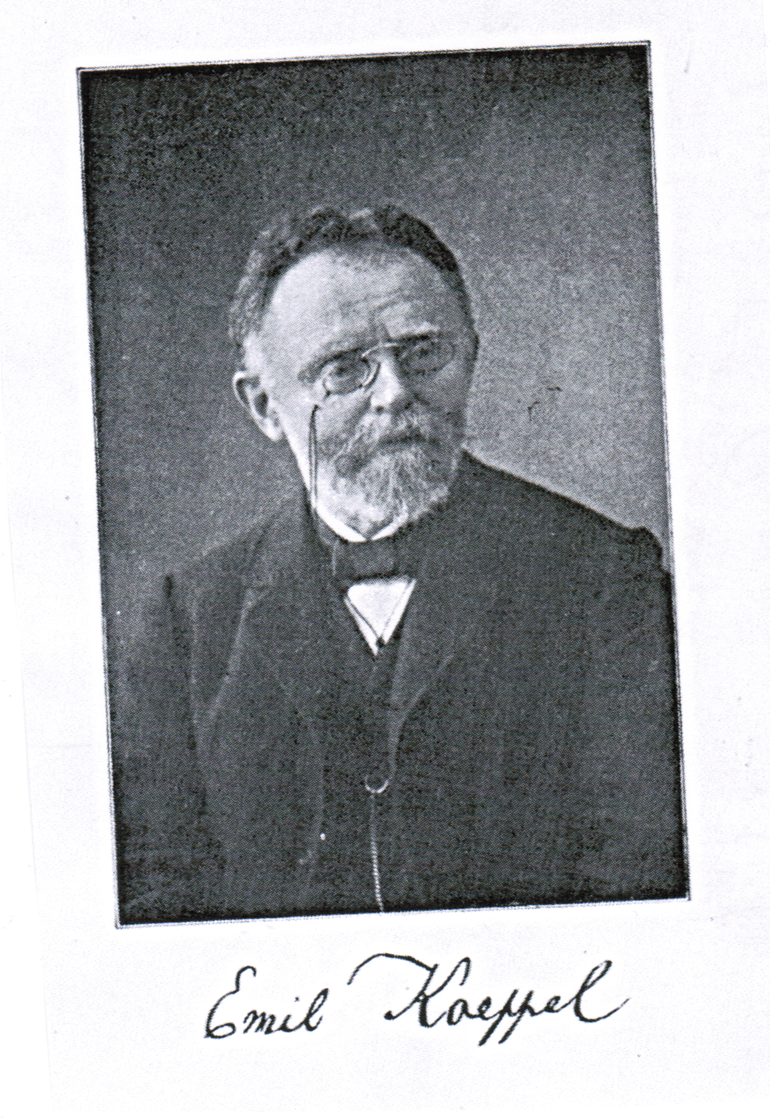
Emil Koeppel 1852-1917
(University of Strasbourg)
published widely and supervised
about 20 PhDs
on sources and influences
in early modern English drama

Slide 25
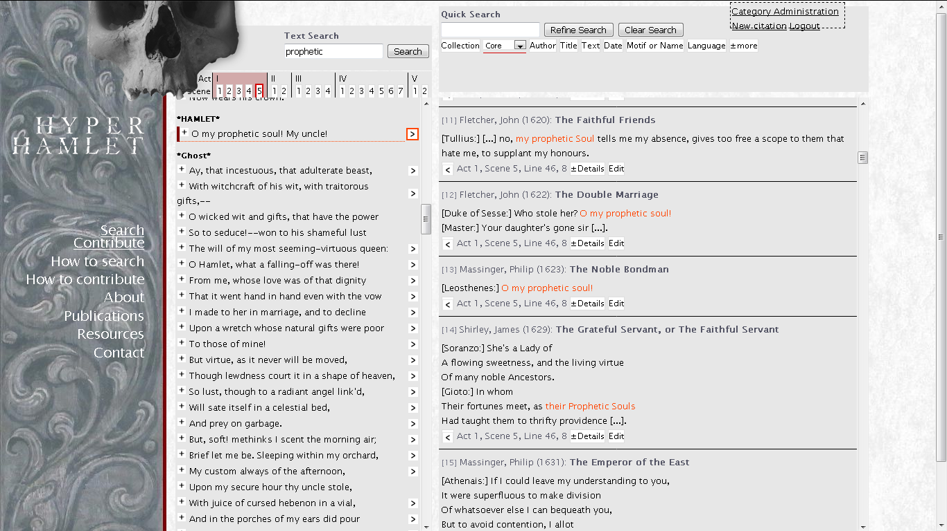

Slide 27
WordWeb / IDEM
The Corpus
The Website
Research

Slide 28
WordWeb / IDEM
The Corpus
The Website
Research

Slide 29
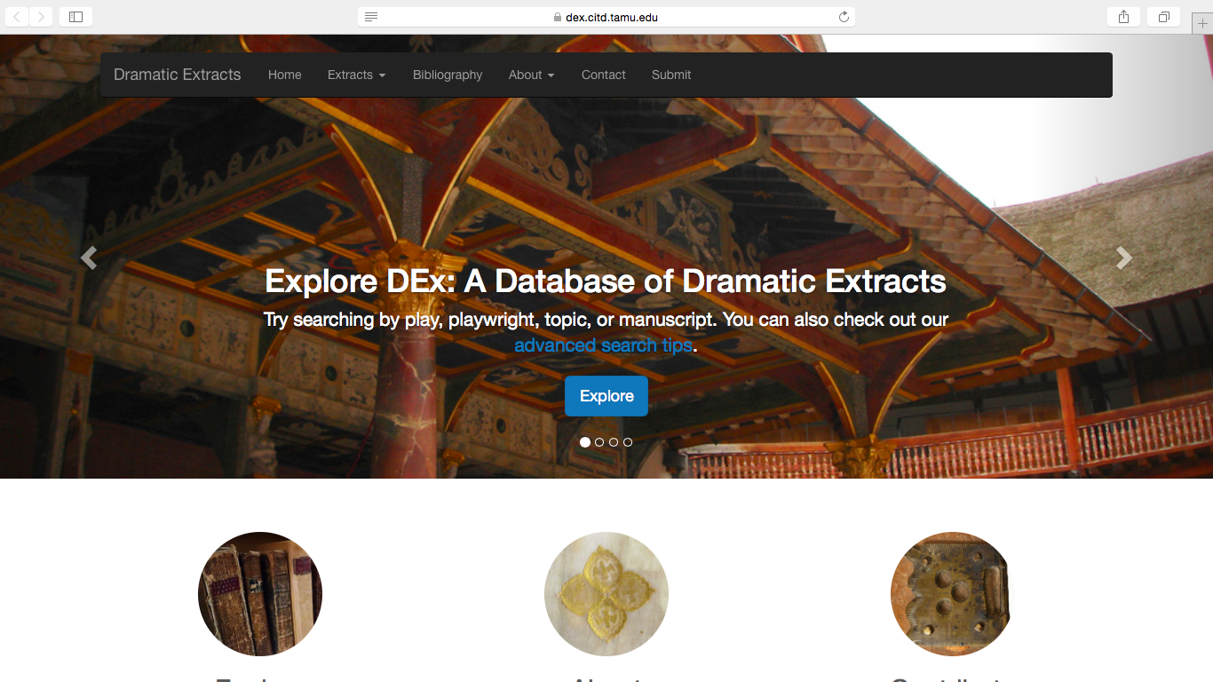

Slide 30
By Playwright

Slide 31
By Play

Slide 32
Browse all
Filter and stats tool

Slide 33
The Website
Queries in DEx or WordWeb
Show me all entries ...
from plays by John Marston
from The Atheist's Tragedy
from plays written between 1586 and 1589
from plays first performed in 1601 by the Admiral's Men
from comedies

Slide 34
WordWeb / IDEM
The Corpus
The Website
Research

Slide 35
Research
Specific queries in WordWeb
Show me entries in which the lexia is marked as an intertextual inset.

Slide 36
Lexia marked for "quotation"
[Quadratus:] A horse, a horse, my kingdom for a horse! Look thee, I speak play scraps.
Marston (1601): What You Will

Slide 37
Lexia marked for "quotation"
[Quadratus:] A horse, a horse, my kingdom for a horse! Look thee, I speak play scraps.
Marston (1601): What You Will

Slide 38
Lexia marked for "quotation"
[Ferneze:] Your smiles have been my heaven, your frowns my hell, O pity then; Grace should with beauty dwell. [Maquerelle:] Reasonable perfect, by'r-lady.
Marston (1603): The Malcontent

Slide 39
Lexia marked for "quotation"
[Ferneze:] Your smiles have been my heaven, your frowns my hell, O pity then; Grace should with beauty dwell. [Maquerelle:] Reasonable perfect, by'r-lady.
Marston (1603): The Malcontent
[Hermia:] O, then, what graces in my love do dwell That he hath turned a heaven unto a hell!
Shakespeare (1595): A Midsummer Night's Dream

Slide 40
Lexia marked for "quotation"
[Wagtail:] Why, what amends will you make me, can you give me some sum of money to marry me to some Tradesman, as the play says?
Field (1609): A Woman Is A Weather-Cock
In Beaumont and Fletcher's The Woman-Hater (1606),
a prostitute marries a mercer.

Slide 41
Lexia marked for "quotation"
[Drawer:] [...] Bess Turnup swears all the gentlewomen went to see a play at the Fortune, and are not come in yet, and she believes they sup with players. [Tear-Chops:] Damn me, we must kill all those rogues, we shall never keep a whore honest for them.
Field (1610): Amends for Ladies
The Honest Whore (Thomas Middleton 1605) was first performed at the Fortune Theatre and Nathan Field acted in that production.

Slide 42
Research
Complex queries in WordWeb
Show me …
entries in which Shakespeare quotes* Marlowe
entries in which Albovine quotes Othello
entries from tragedies which are quoted in comedies
* [uses lexias which were earlier used by]

Slide 43
Research
Complex queries in WordWeb
Show me all entries which contain…
… lexias quoted from Hamlet, sorted by author
… lexias quoted by Shakespeare, sorted by decade
… plays quoted by John Marston, sorted by genre
… all lexias sorted by year or decade of their first use

Slide 44
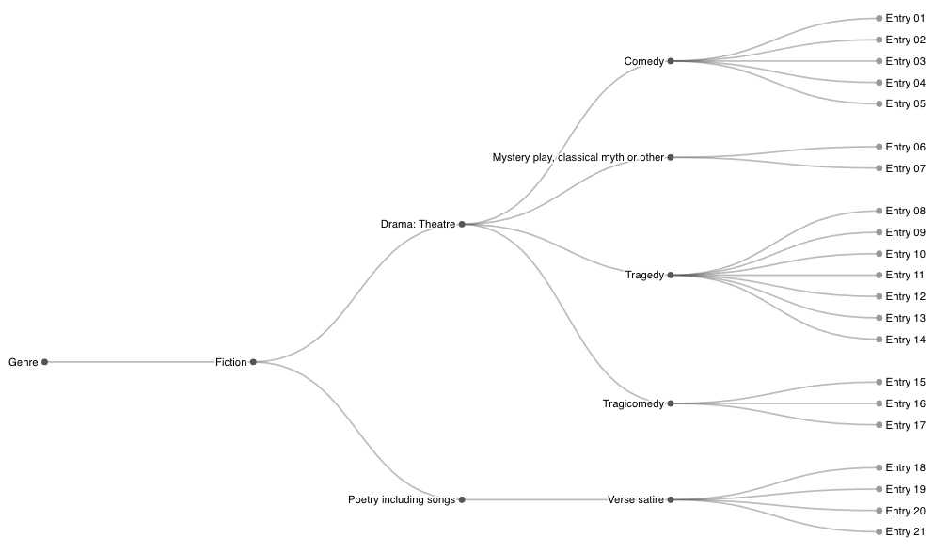
Distant reading:
… plays quoted by John Marston, sorted by genre

Slide 45
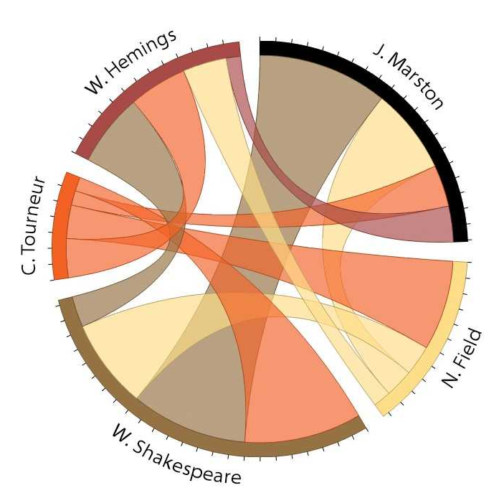
Distant Reading
Lexias shared between John Marston, William Shakespeare, William Hemings, Cyril Tourneur and Nathan Field

Slide 46
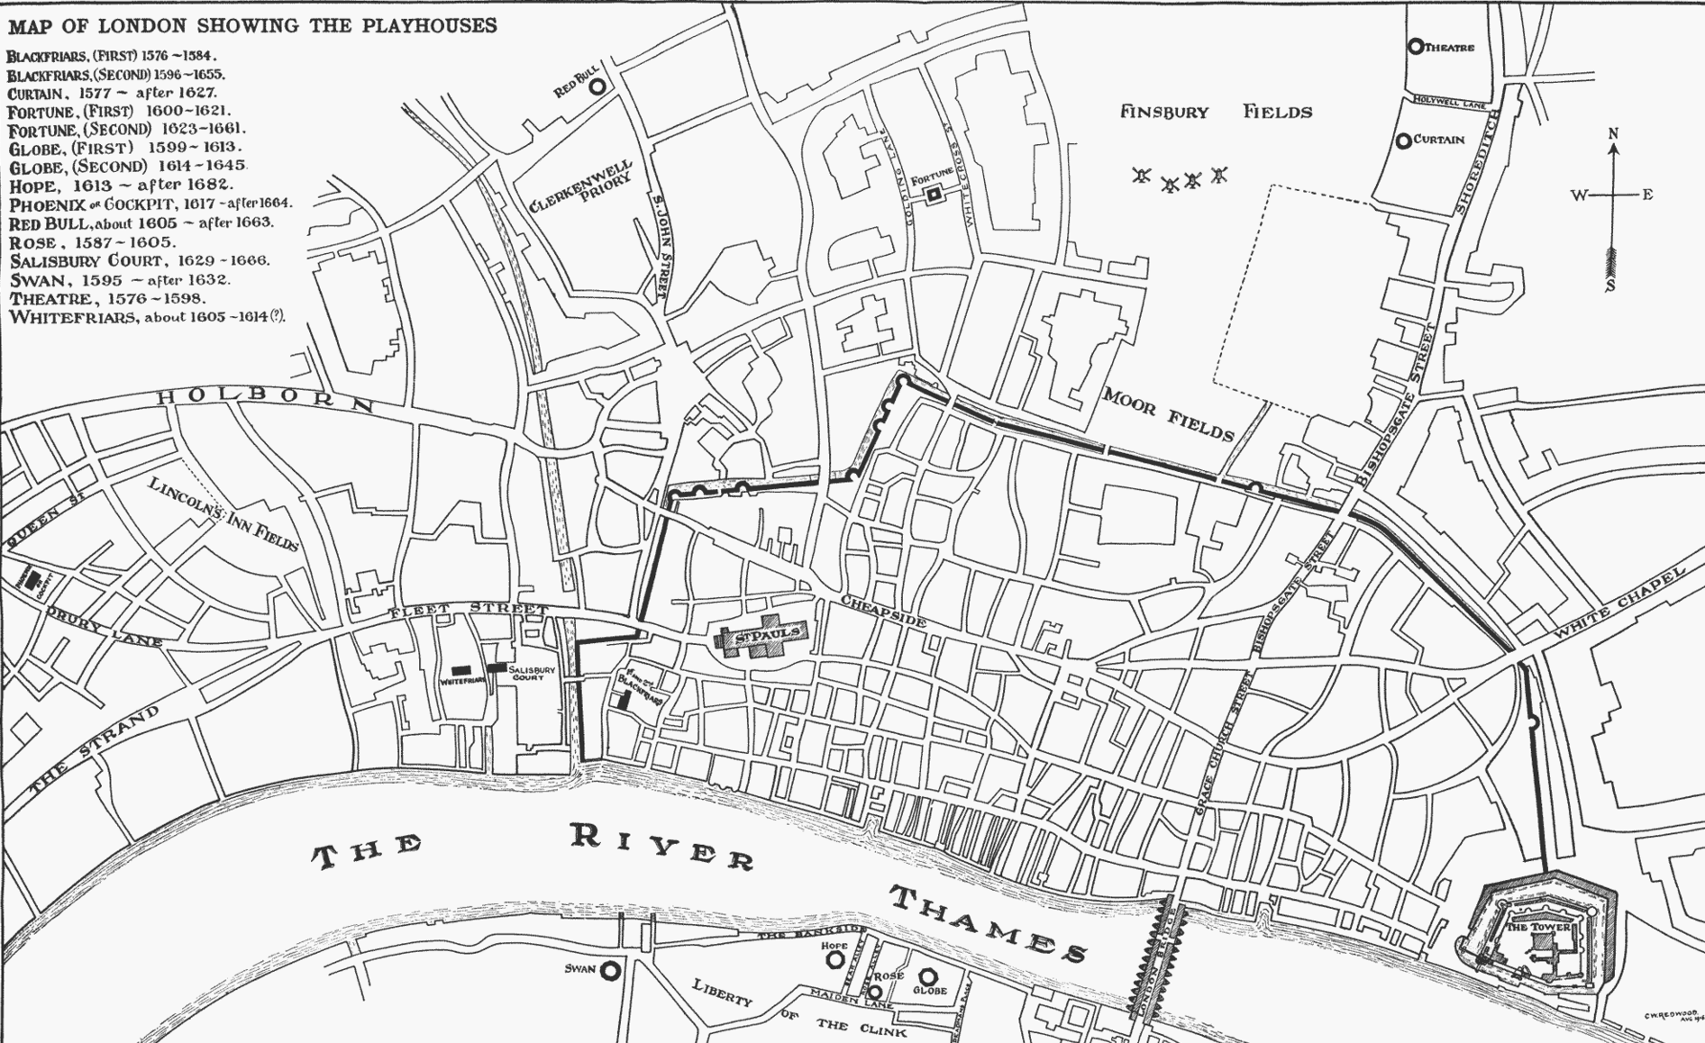
Lexias circulating
in London theatres

Slide 47
Text
"Look thee, I speak play scraps"
Mapping early modern intertextuality
reviving results of historical scholarship
contextualizing them with electronic searches
sorting and linking the complex data
making data available and accessible

